Slide 1
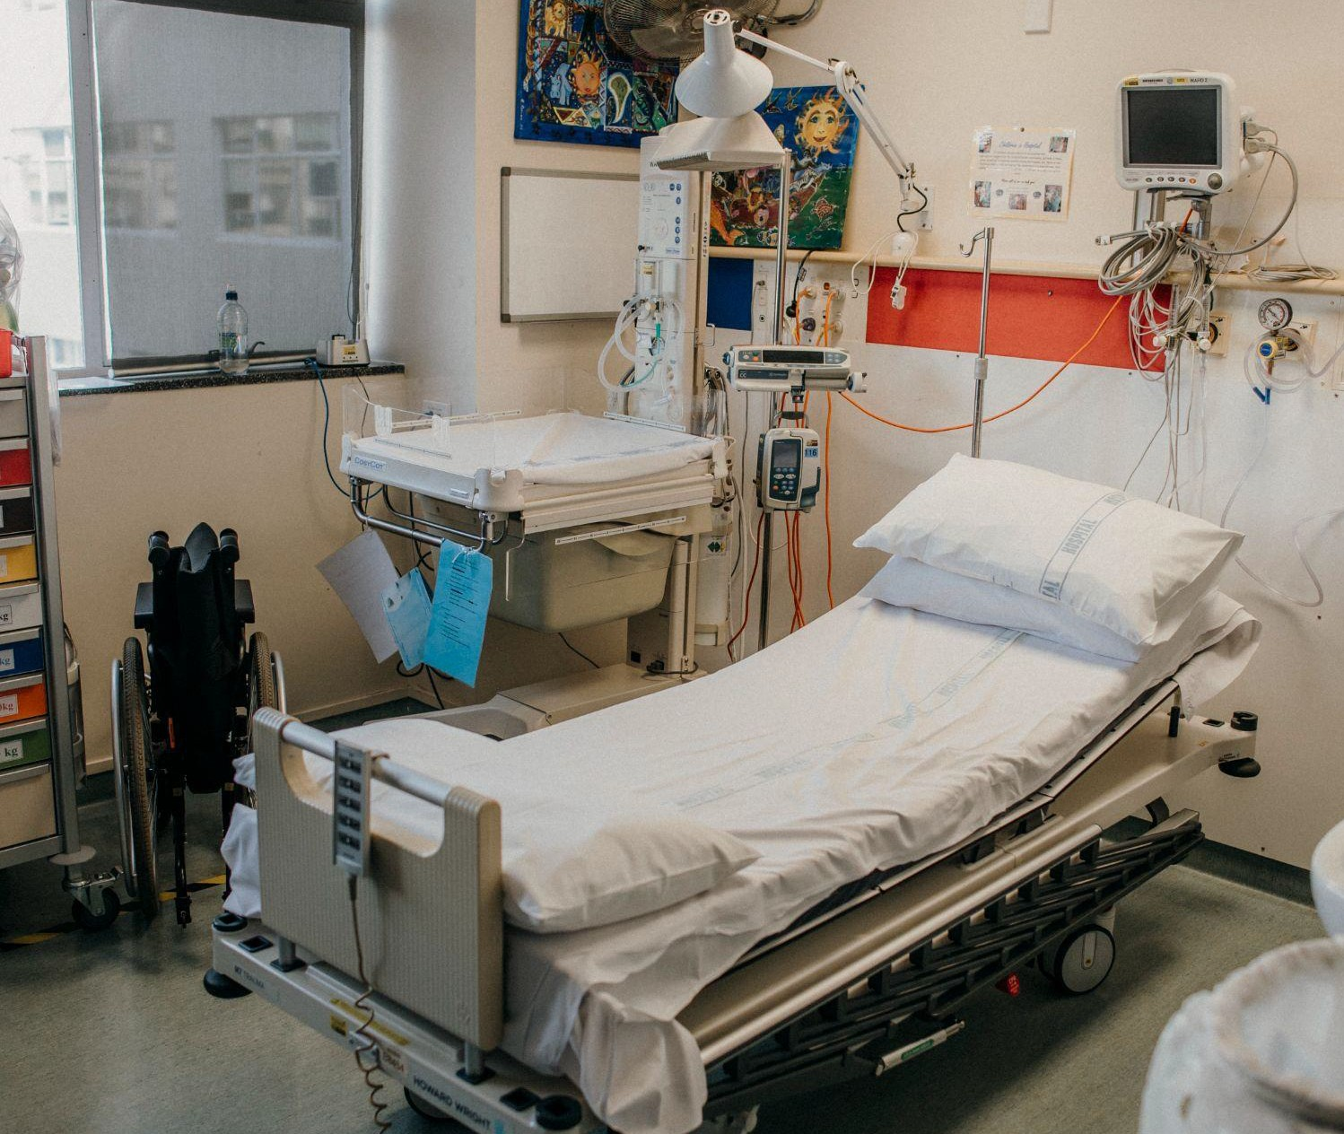
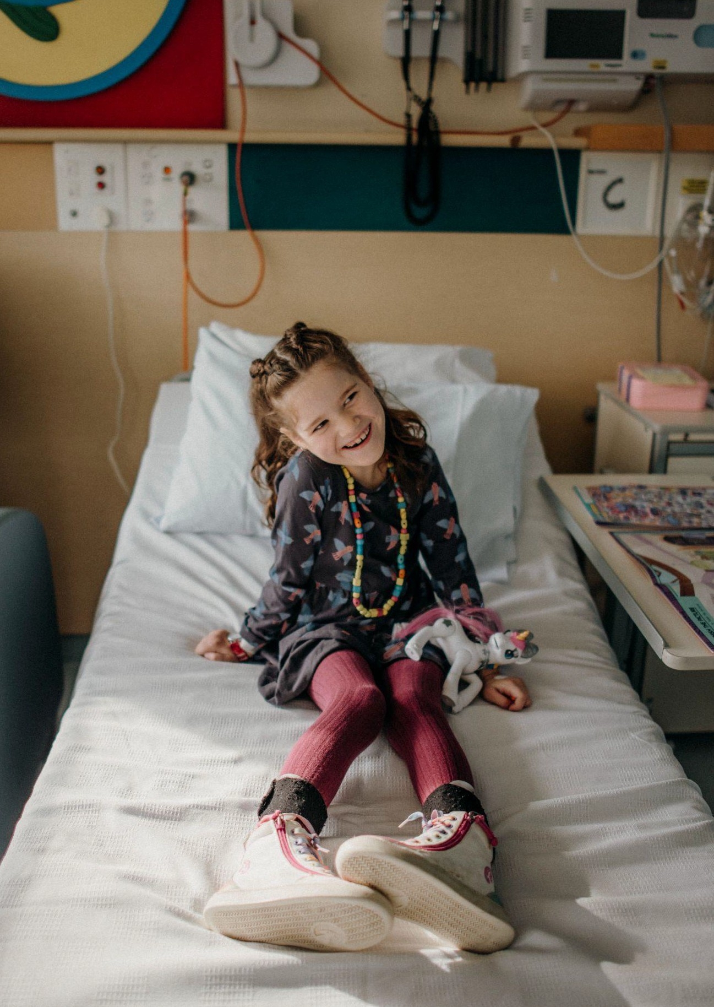
Whangārei Children’s Ward Refurbishment:
Mackenzie’s Story

Slide 2
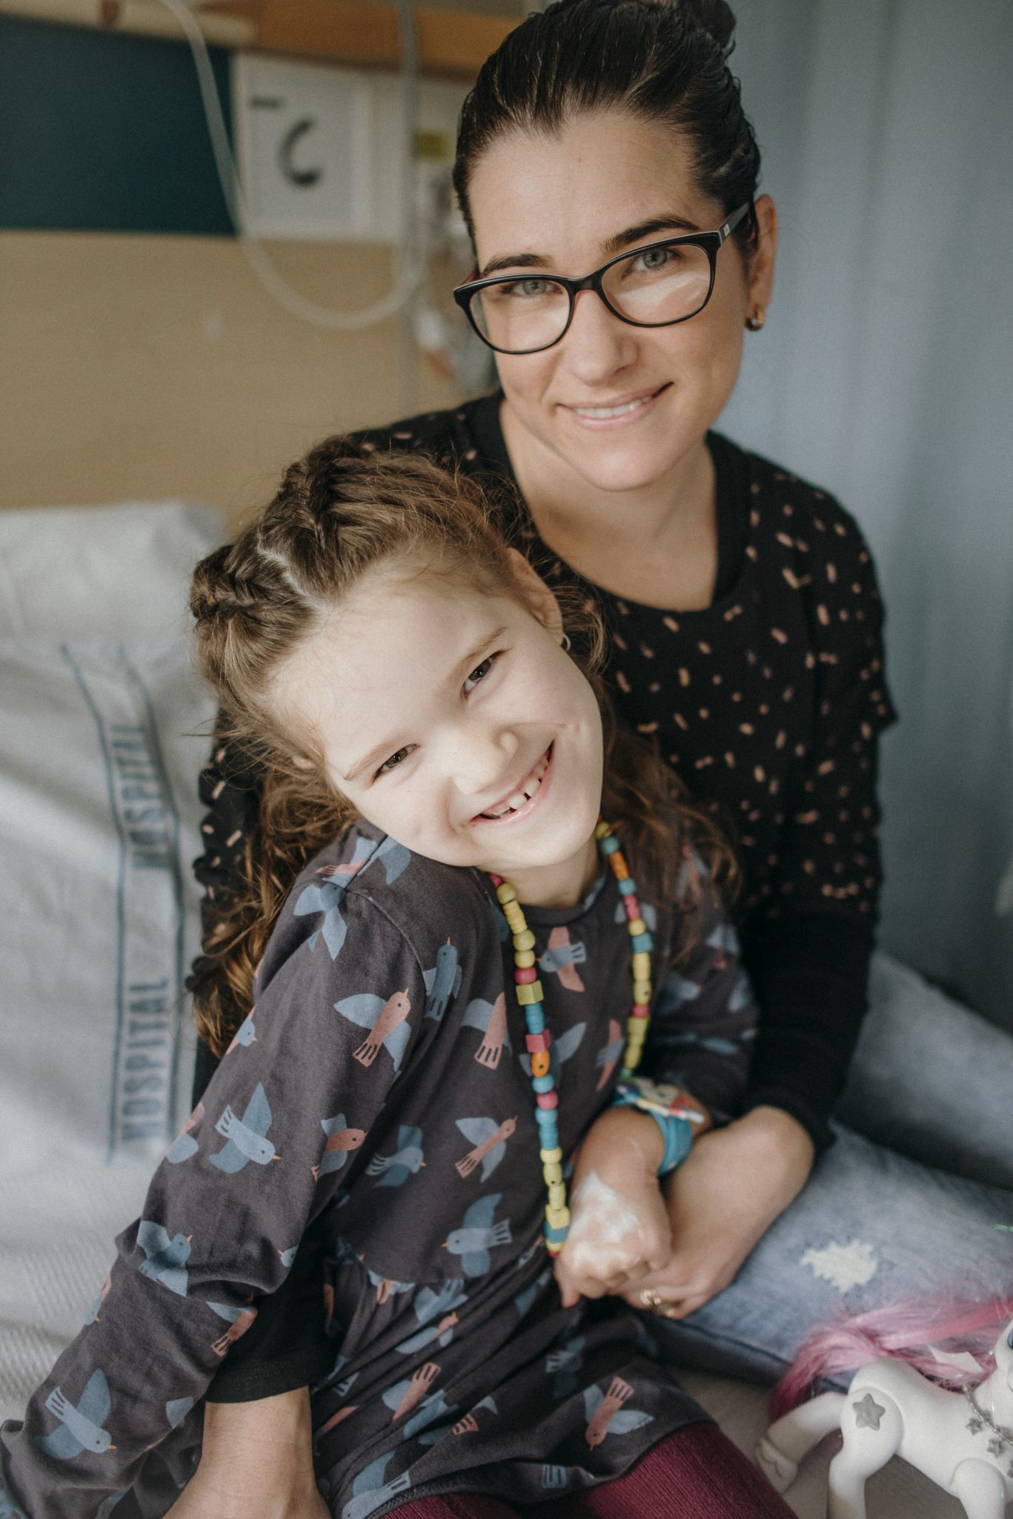
Whangārei Children’s Ward Refurbishment
Mackenzie’s Story
Kia ora, my daughter's name is Mackenzie, and at the end of January 2020, Mackenzie’s health declined signiﬁcantly over the space of a few days. Mackenzie was looked after by the Whangarei Children’s Ward (in hospital) until she became too unwell and was airlifted to hospital in Auckland. Mackenzie spent six weeks in Auckland before coming home to Northland. A few weeks later Mackenzie’s genetic testing revealed that she has a combination of two rare genetic conditions, which she will have for the rest of her life – Rapid-onset dystonia parkinsonism and Alternating Hemiplegia of Childhood. Since this time, we have had numerous visits to the Whangarei Children’s Ward both as an acutely unwell patient and for her three weekly infusions that she now has.
Mackenzie also has many child health services supporting her in the community–medical outreach nurses, physio, occupational therapist, and dietician.

Slide 3
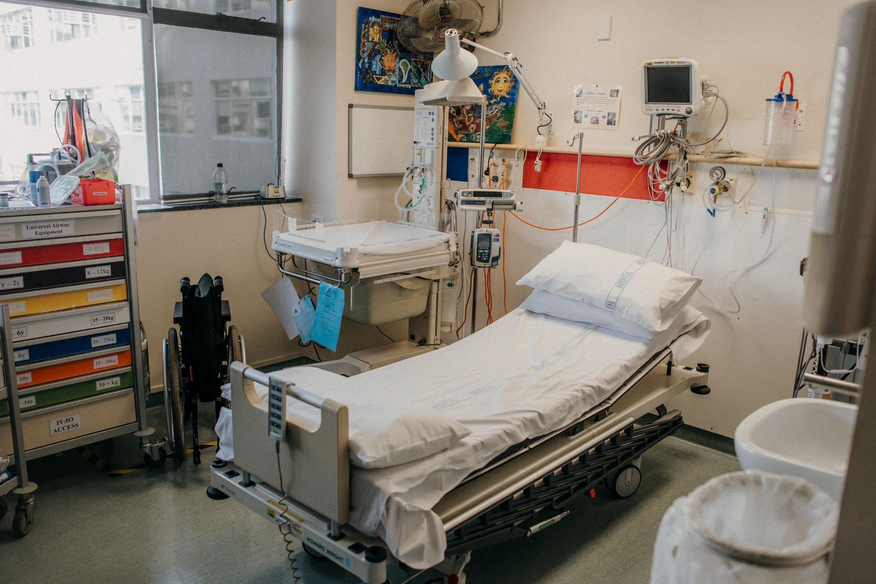
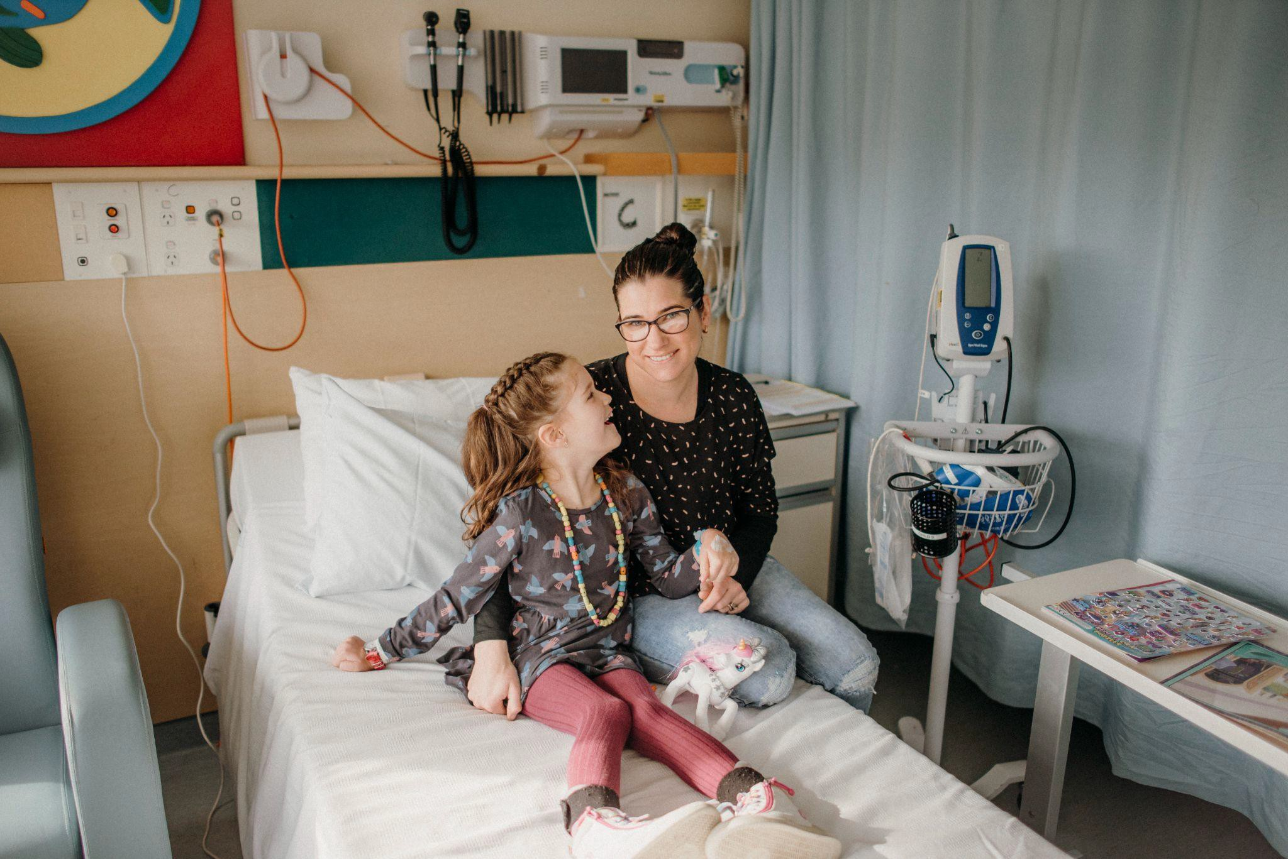
Mackenzie has limited mobility, a movement disorder, dystonia, she only eats a small amount by mouth and can no longer speak properly, the list goes on. She has loads of barriers in her life now, however with a smile on her face, and the help we get from everyone in the Northland DHB and Whangarei Children’s Ward she is determined to just keep ﬁghting and moving forward. There are many things she still can still do and those are the things we choose to focus on as a family. Although the past 18 months has been extremely tough and challenging it is a privilege to help raise public awareness that the Whangarei Children’s Ward needs a major revamp to become the family friendly healing space that it should be, and can be!
Before
Treatment Room
Patient Room

Slide 4
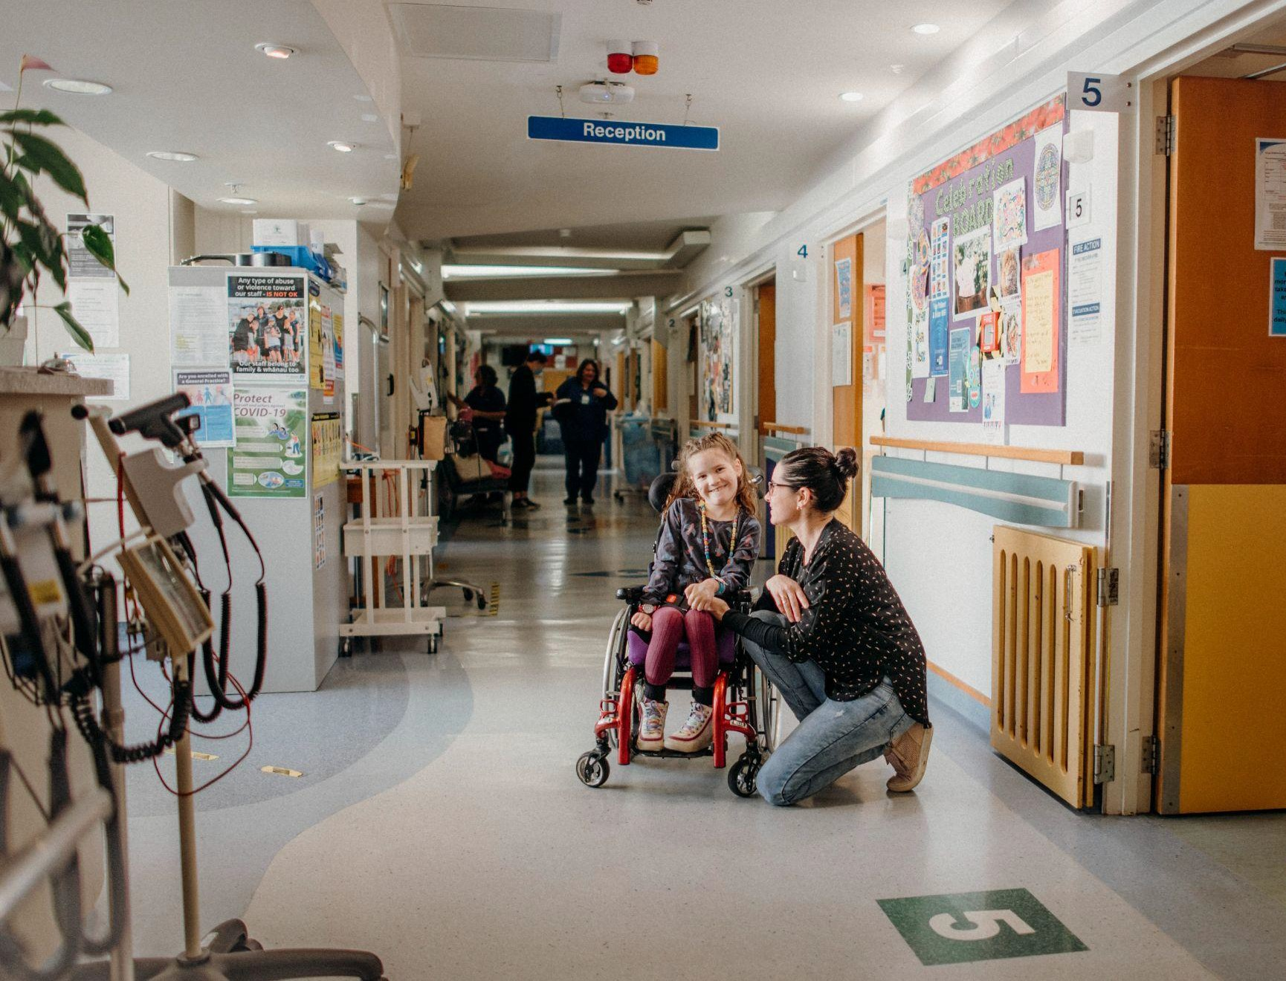
Mackenzie is always happy to head to the hospital for the day, which is a testament to the staﬀ, the care and time they give her after everything she has been through. Whangarei Children’s Ward is always staﬀed by a friendly team of nurses, doctors, health care assistants, play specialists, ward clerks and multidisciplinary team.
It is obvious that the environment on the Children’s Ward could be more child
friendly, family friendly and functional for everyone.
I can see that the upgrades and planned refurbishment would greatly improve the environment making it a calmer and more restful place for all children and family to heal and recover. Thank you for your support for this appeal, and the diﬀerence it will make to other children like Mackenzie.
Yours, Rochelle.

Slide 5
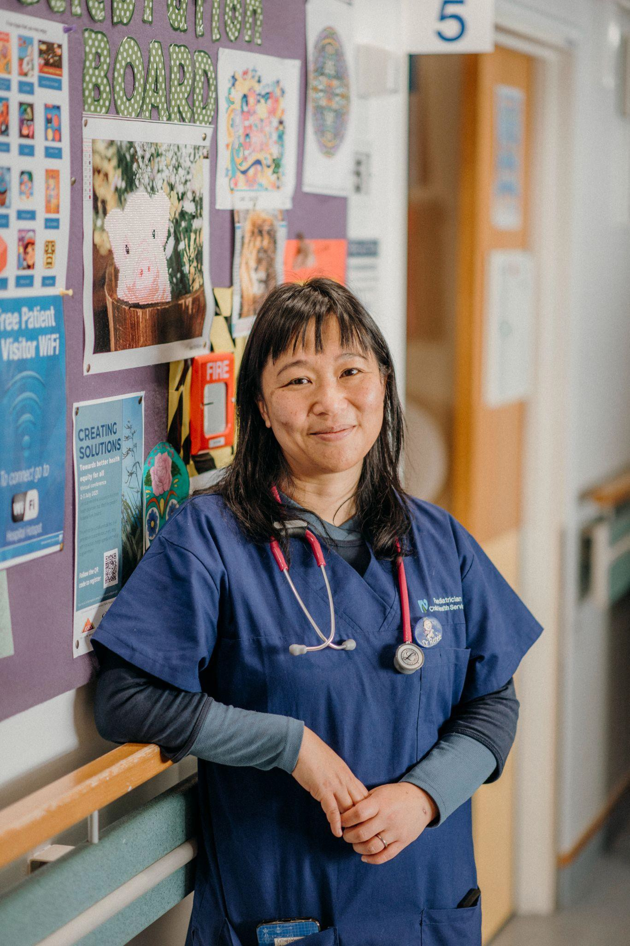
“When we care for the whole family, our treatment becomes a lot more effective. This is the principle of whānau-centred care: the child, cradled within the support of their whānau. Your gift will help our staff to care for the whole whānau and make their time in hospital a lot easier.”
Paediatrician Dr Renee Liang
Title

Slide 6
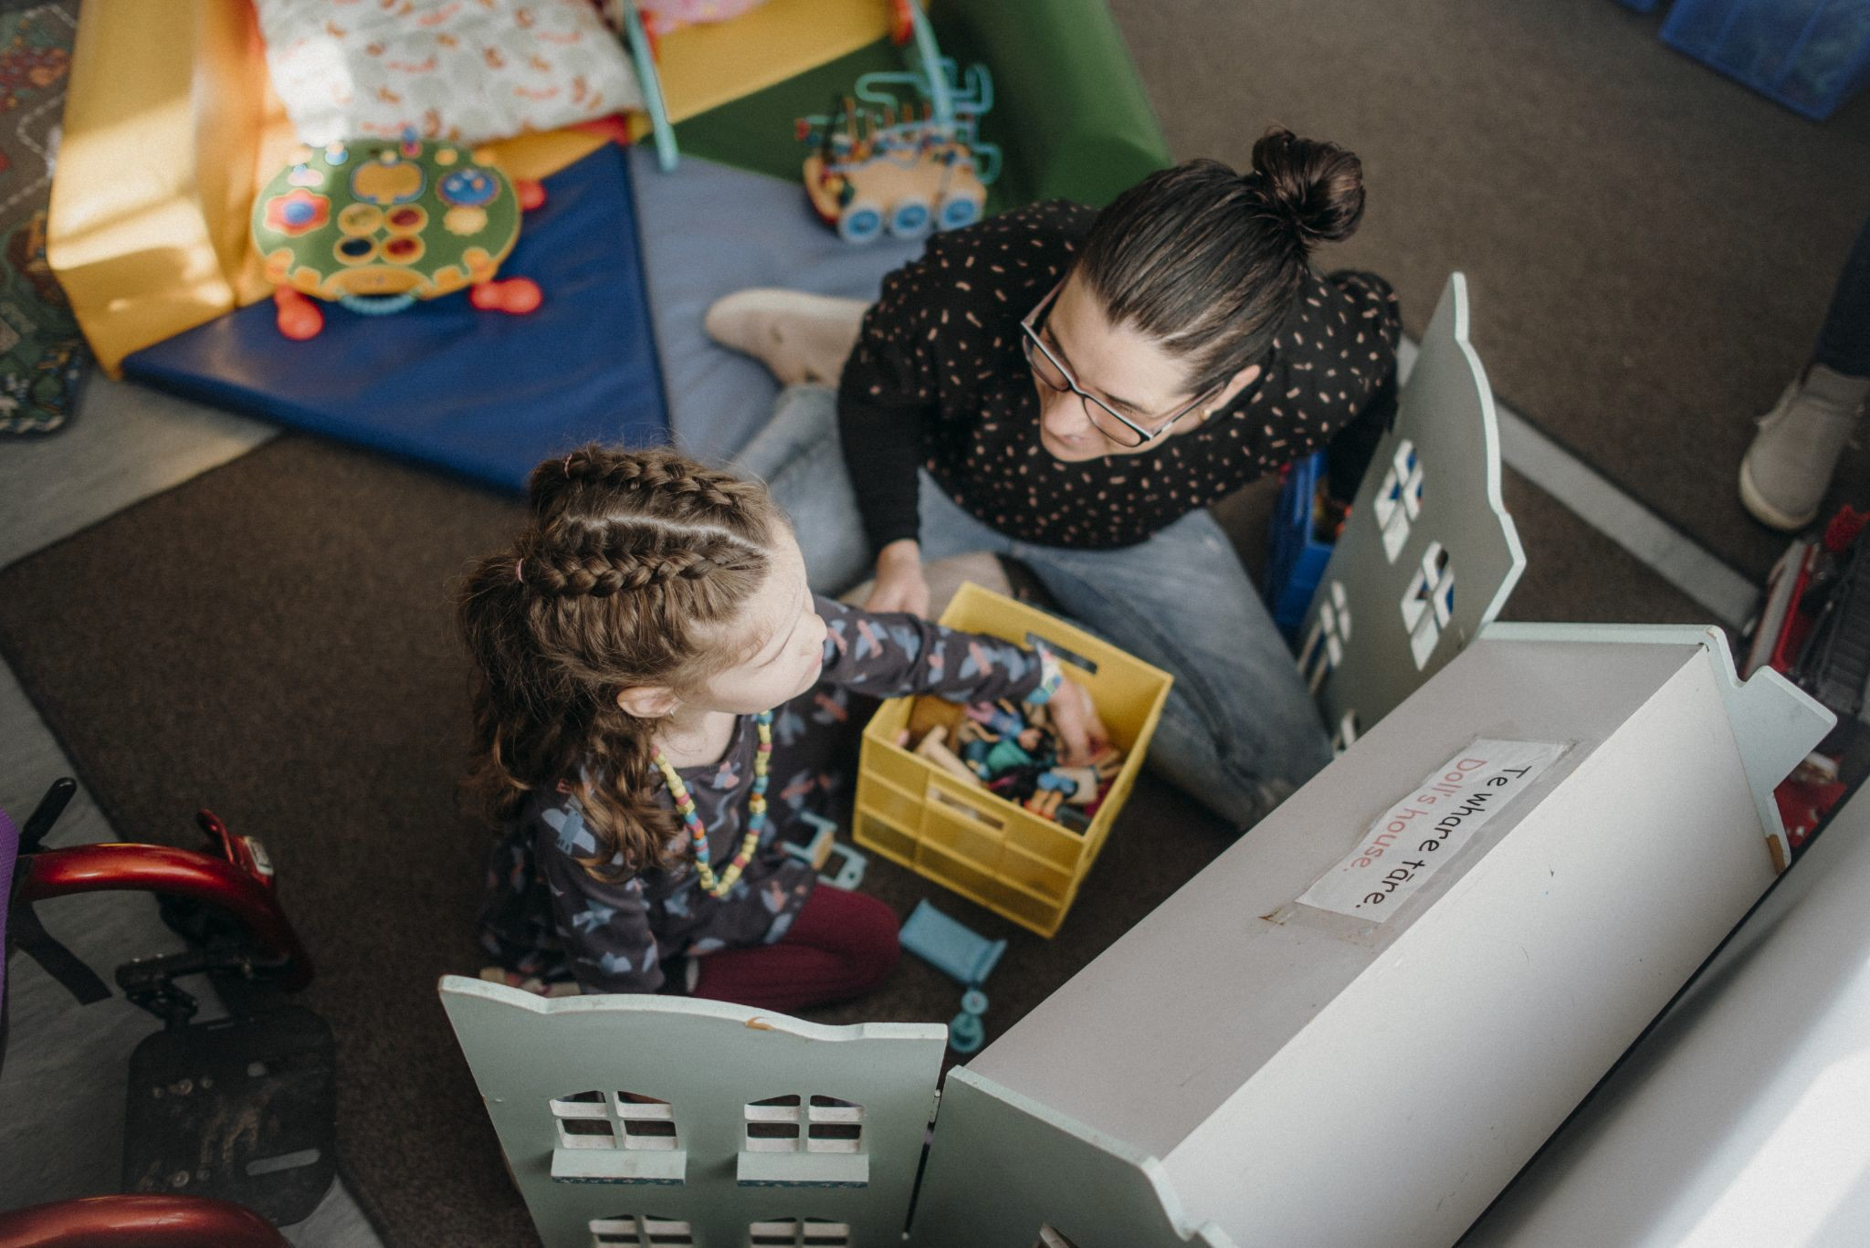
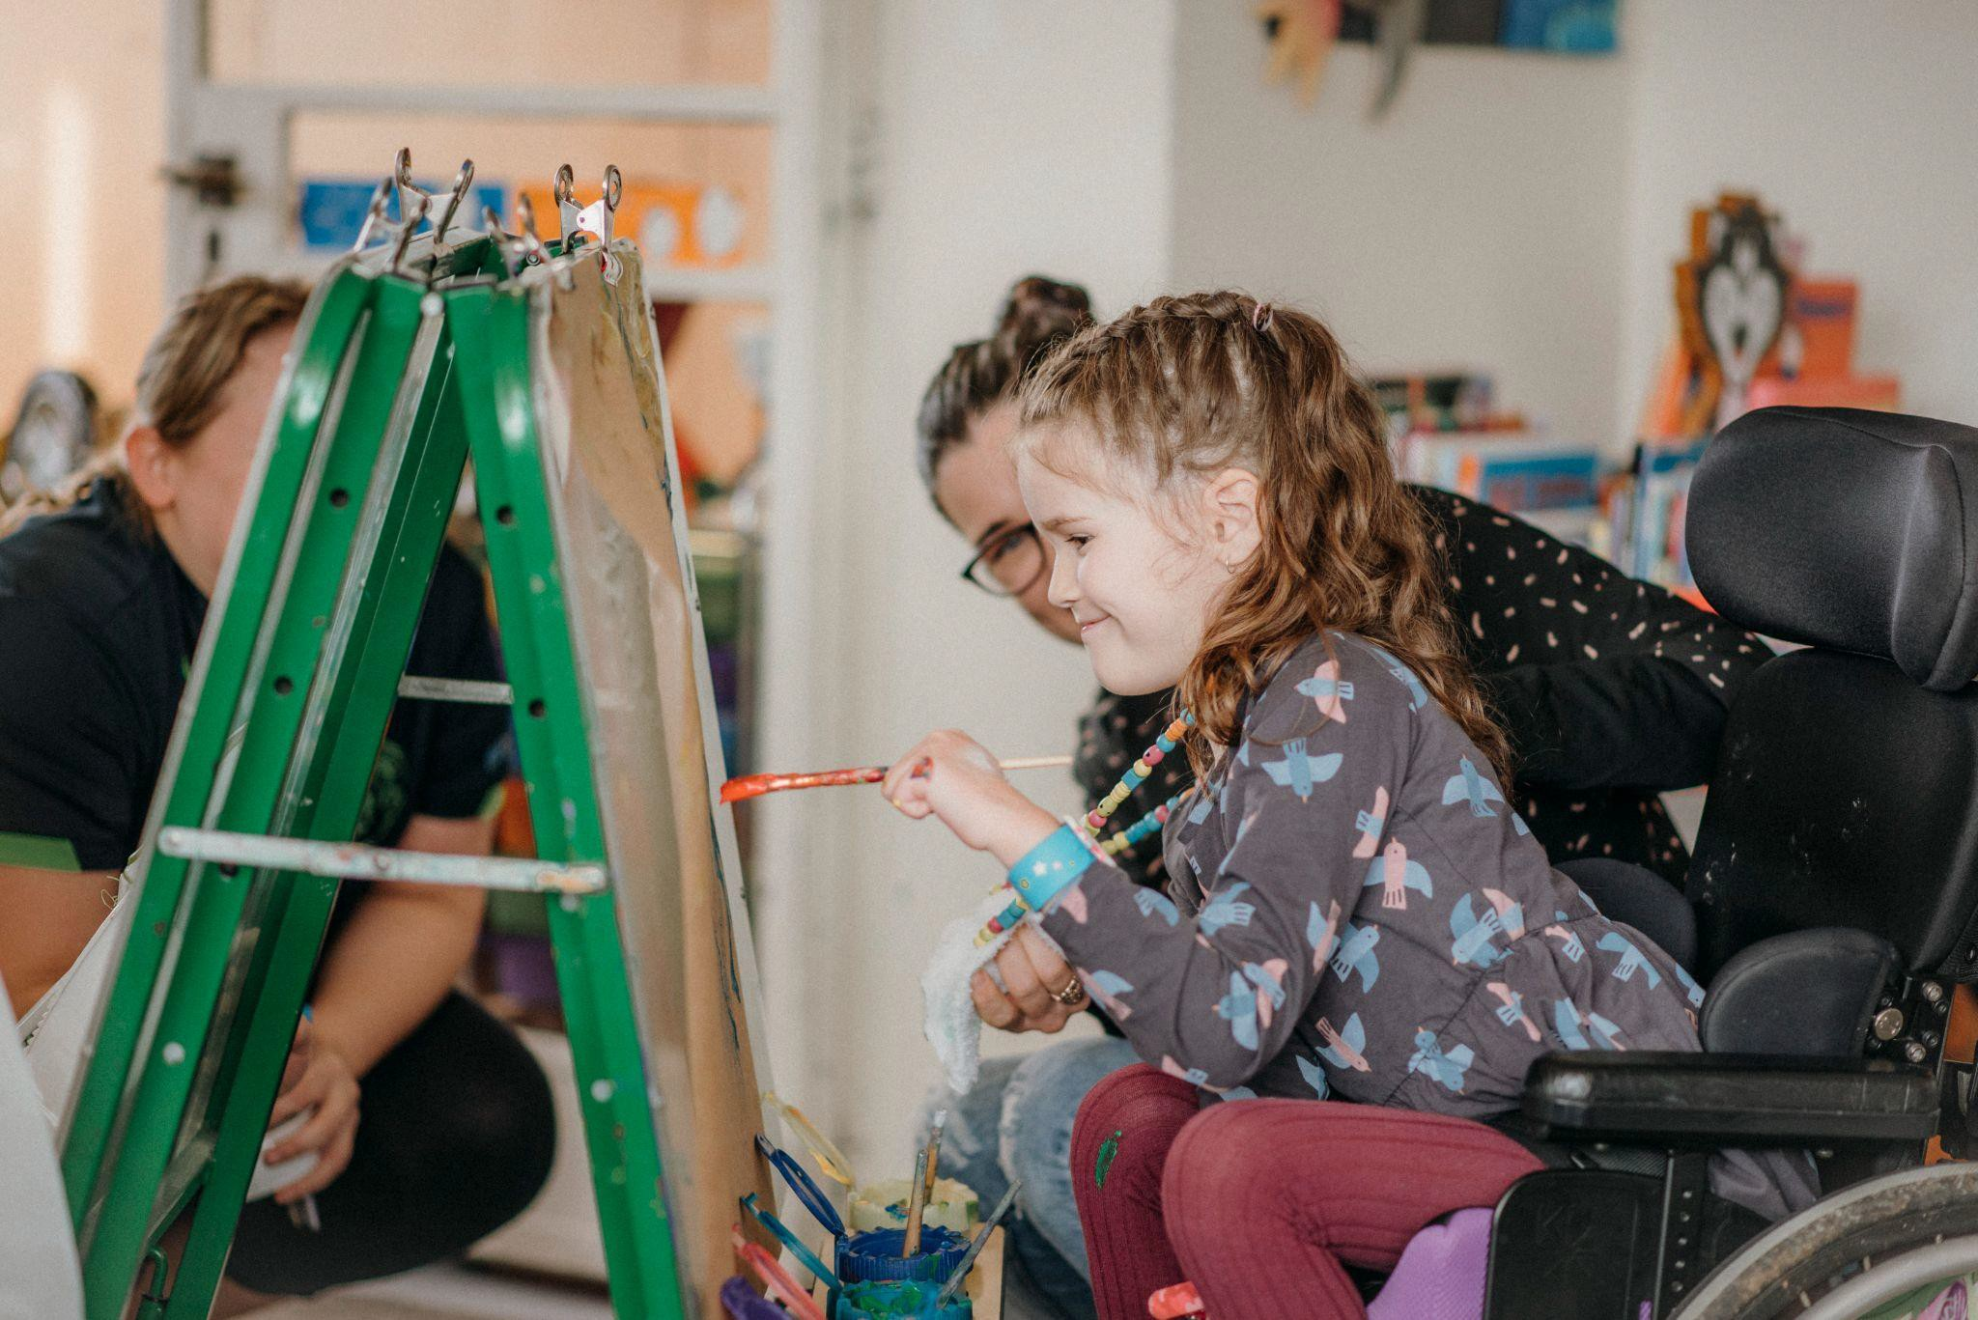
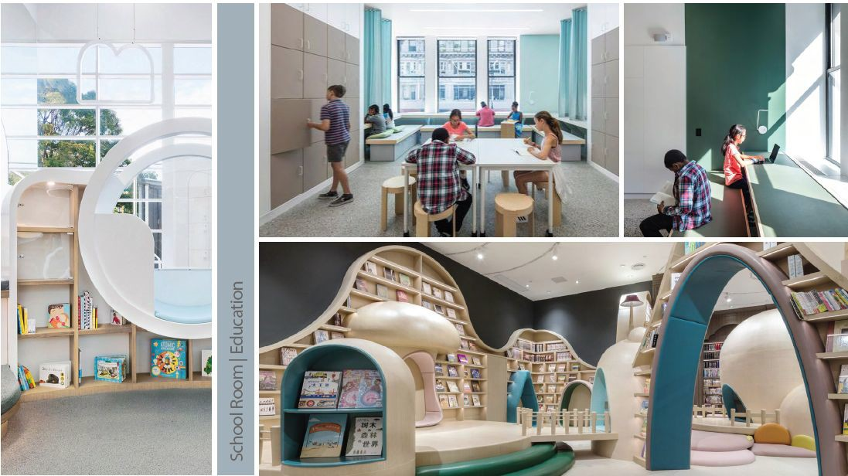
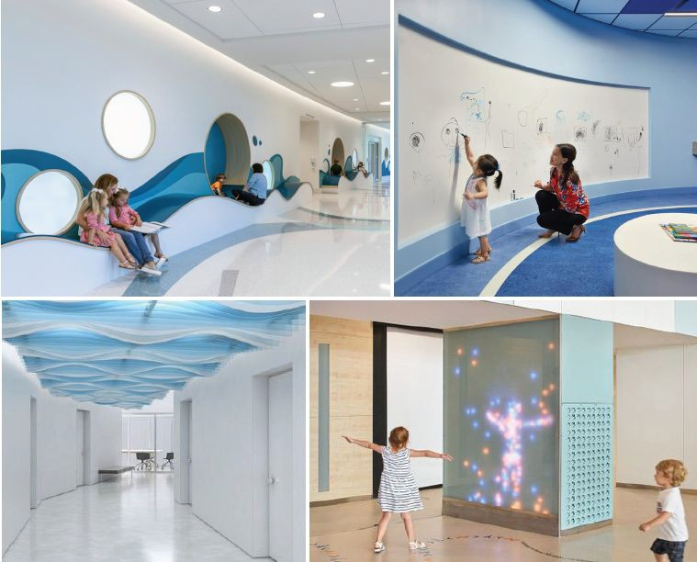
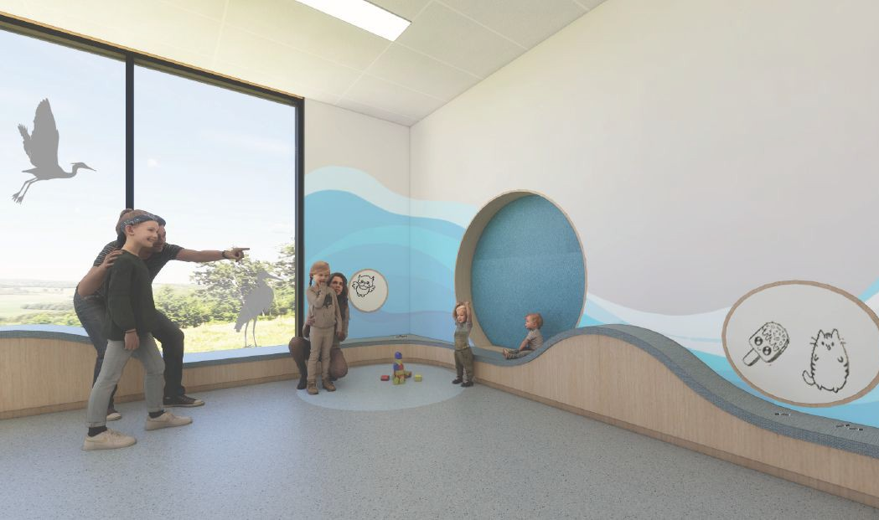
Playroom
BEFORE
AFTER
Indicative Only

Slide 7
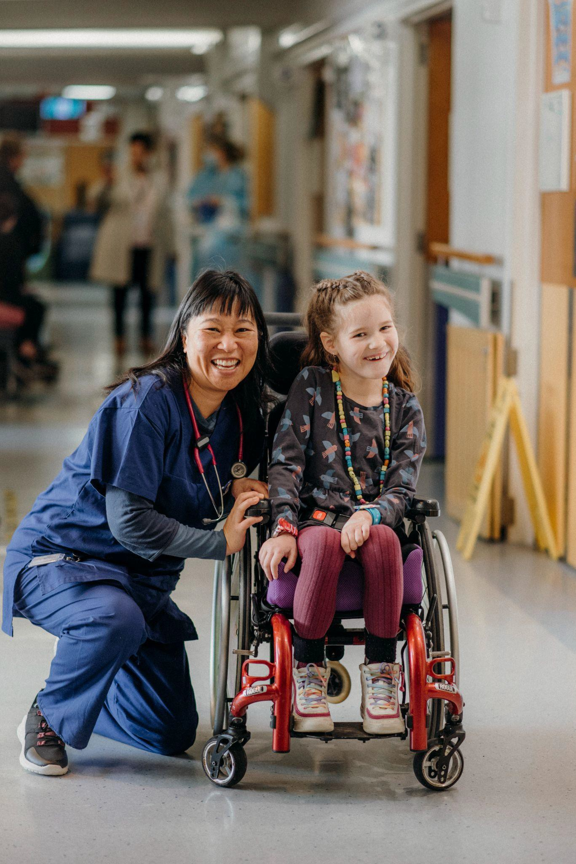
How to get in touch?
If you have any questions or would like to donate, please don’t hesitate to give us a call or email us:
Phone: Greta Buchanan 021 558 224 or Sophie Lane 0204 139 8518
Email: info@northlandcommunityfoundation.org.nz Postal Address: PO Box 10011, Te Mai, Whangārei 0143. Website: www.northlandcommunityfoundation.org.nz Facebook: www.facebook.com/ncf

